Slide 1
Faith-Based and Community Engagement
TCCWB Conference
February 24, 2025

Slide 2

Mission and Vision
DFPS Mission
We build on strengths of families and communities to keep children and vulnerable adults safe, so they thrive.
DFPS Vision
Safe children and adults. Strong families and communities. Stronger Texas.
FBCE Vision
Connecting caring communities.

Slide 3
DFPS Annual Plan:
A Way Forward, Volume II
Goal 1:
Child Protection Evolution
Goal 2:
Strengthening Families and Communities
Goal 3:
Support and Retain Workforce
Goal 4:
Addressing Children Without Placement

Slide 4
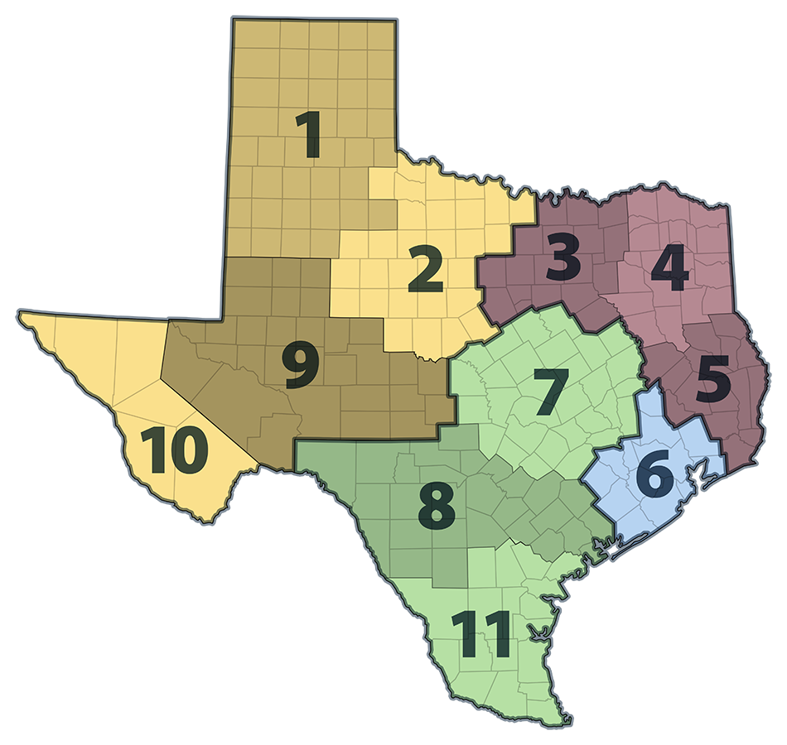
FBCE Regional Leadership
Paige Belew – 1, 2, 9, 10
Starla Abraham – 3, 4, 5
Alysa Elliott-Wilson - 6
Kimberly Hill – 7, 8, 11
Gustavo Salinas - APS Statewide

Slide 5
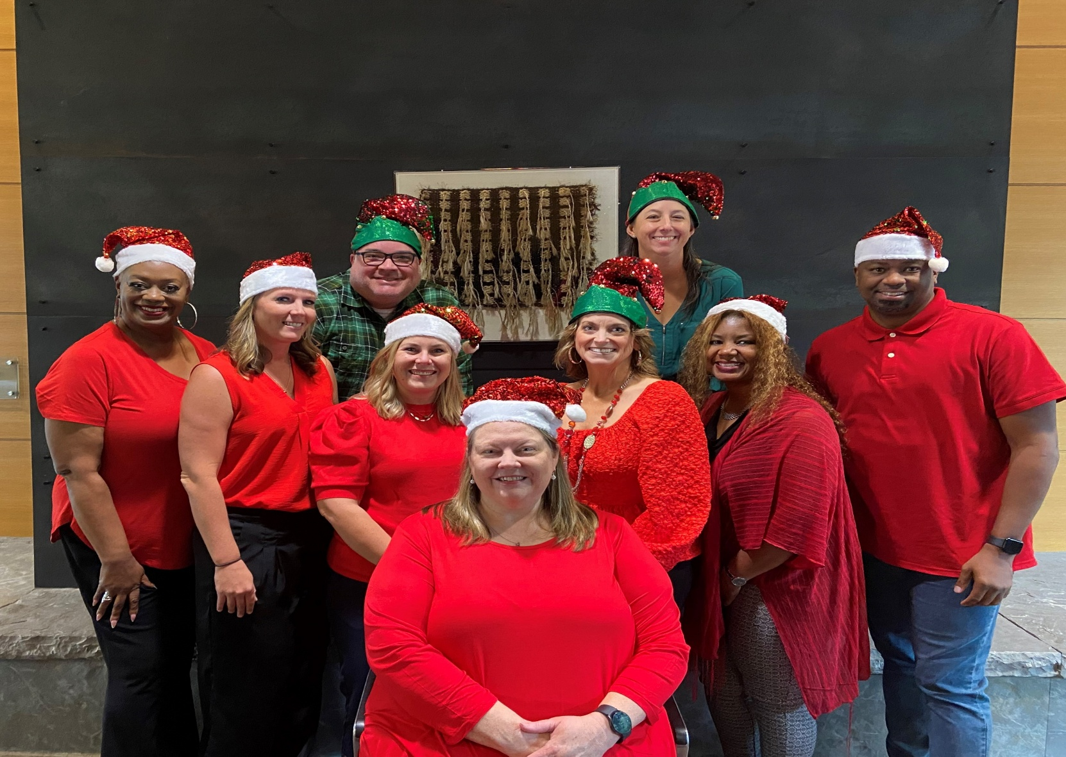
FBCE Leadership Team

Slide 6




FBCE Initiatives

Slide 7
Awareness Months
Month | Topics | Month | Topics
Jan | Human Trafficking Awareness | July | National Intern Day
March | Social Worker Appreciation | Aug | Back to School
April | Child Abuse Prevention Volunteer Appreciation Week | Sept | Baby Safety Suicide Prevention Healthy Aging
May | Foster Care Awareness Mental Health Awareness Older Americans Water Safety | Oct | Financial Exploitation Awareness Clergy Appreciation Domestic Violence Awareness National Night Out (Texas)
June | Elder Abuse Awareness Family Reunification | Nov | Adoption Awareness Military Appreciation

Slide 8
Trainings and Presentations
FBCE staff are available to provide presentations and trainings virtually or in person on a variety of topics including:
APS 101
CPS/CPI 101
Mandatory Reporting

Slide 9
FBCE By The Numbers – FY24
Community Events:
  1,547 events
  131,804 attendees
Resource Support:
  19,460 clients and families served
Estimated Donations:
  $2,654,559
Presentations:
  796 presentations
  28,178 attendees

Slide 10
Volunteers and Interns
Volunteers and interns work in various areas of the agency helping with the following:
Direct Service with Clients (CPS, CPI and APS)
Emergency Resource Rooms
Special Events and Initiatives
Youth & Parent Helplines

Slide 11



FY 24 Volunteer Impact
1,373
volunteers & interns
52,460
hours
$864,357
in value

Slide 12

Volunteer Award Winner – Jennifer Kremer-Oliva

Slide 13
Partnering with CWB’s
Run initial and annual background checks on members
Liaison with local boards
Manage resources/rooms when no CWB exists
Train on DFPS programs
Collaboration with Single Source Continuum Contractors (SSCC)

Slide 14
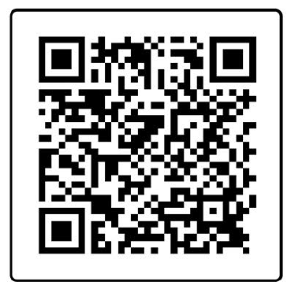
Sign up for information

Slide 15
Thank You!
Rachel Duer
Rachel.Duer@dfps.texas.gov
512-701-7353

