Slide 1
Welcome to
the Texas Council of Child Welfare Board (TCWB) Conference
February 2025

Slide 2
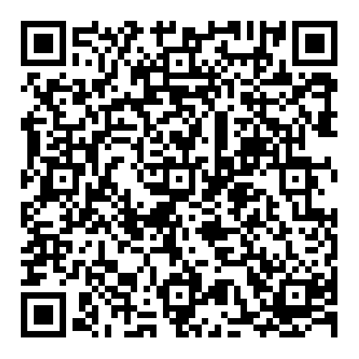
Today’s Topics
Introduction
Goals & Outcomes
Key Processes
How to be Successful
Next Steps
Page #

Slide 3
Who am I? Jason Williams
Husband and Father of Four
New Grandfather (PAPPY)
County Commissioner
  Elected 2011
  Restarted CWB in 2021 for Mills County
Region 7 Board President 2024
TCCWB Board delegate 2022
TCCWB Board Vice President 2024
Rancher and Avid Outdoorsmen
A Christian
Page #

Slide 4
County Boards
LGC Sec.264.005
  The Commissioner’s Court MAY appoint a CWB
  Board shall have not less than 7 members and not more than 15
  Members serve at will of the CC with no compensation
  Two or more counties may establish a board
  The Board shall select a presiding officer
  The Local board is a government unit
    Shall follow the LGC information act and/or the open meeting act
  A CC MAY appropriate funds.
  The CWB MAY provide service and support of all children without regard to immigration status.

Slide 5
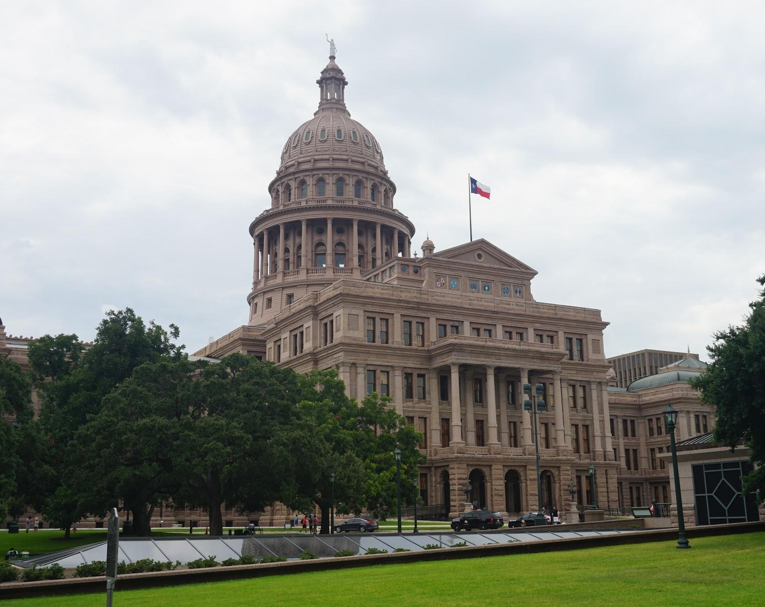
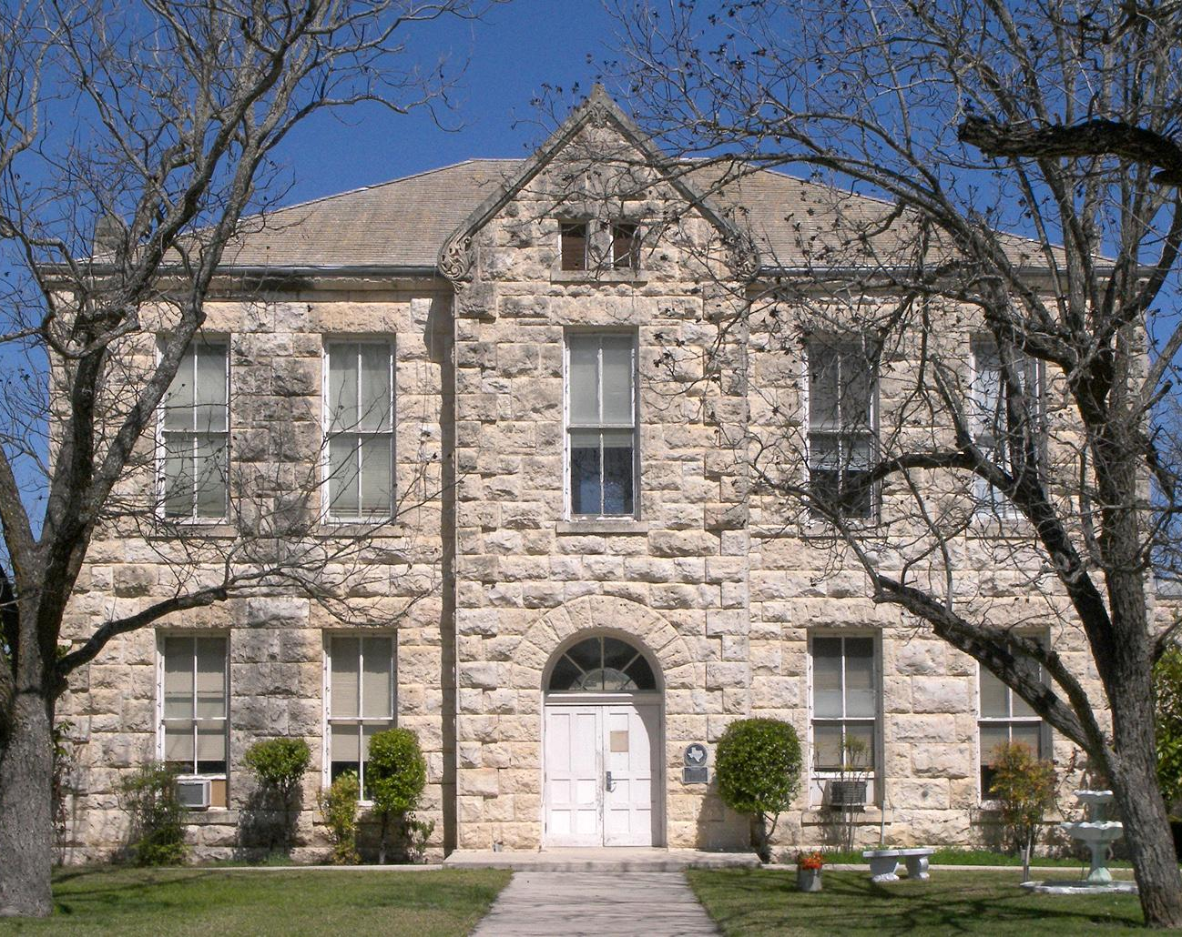
Department of Family and Protective Services (DFPS)
COUNTY
N502 FORM -4510NFCCWS
AGREEMENT
(bilateral contract)
County Child Welfare Service Non-financial Agreement, 7 year agreement

Slide 6
Setting up a Board
Find 7 willing members , up to 15.
Turn members name into the County Commissioner’s Court for approval.
Background checks on the board members
  Volunteer Application Form C: 105-0250
  Volunteer Confidentiality Agreement Form C: 105-0251
  Turn into DFPS representative.
Training
  Open meeting Act ( 30 days) GC Sec. 51
  Public Information Act
The Board shall create Bylaws to be approved by the Commissioner’s Court
  Mission Statement
  Vision Statement
  Membership
  Job Descriptions
  Fixed Meeting Dates
  Term and Amendments
Finances
  501(c) (3)
  County FIN —County Auditor or Treasure

Slide 7
What We Do
Work independently or in collaboration with “rainbow rooms”
Support Holidays for children and workers
Provide Support for Families
Sponsor public awareness
Coordinate with Courts and Judges
Adhere to Community’s needs
Lobby for laws concerning the protection of our children

Slide 8


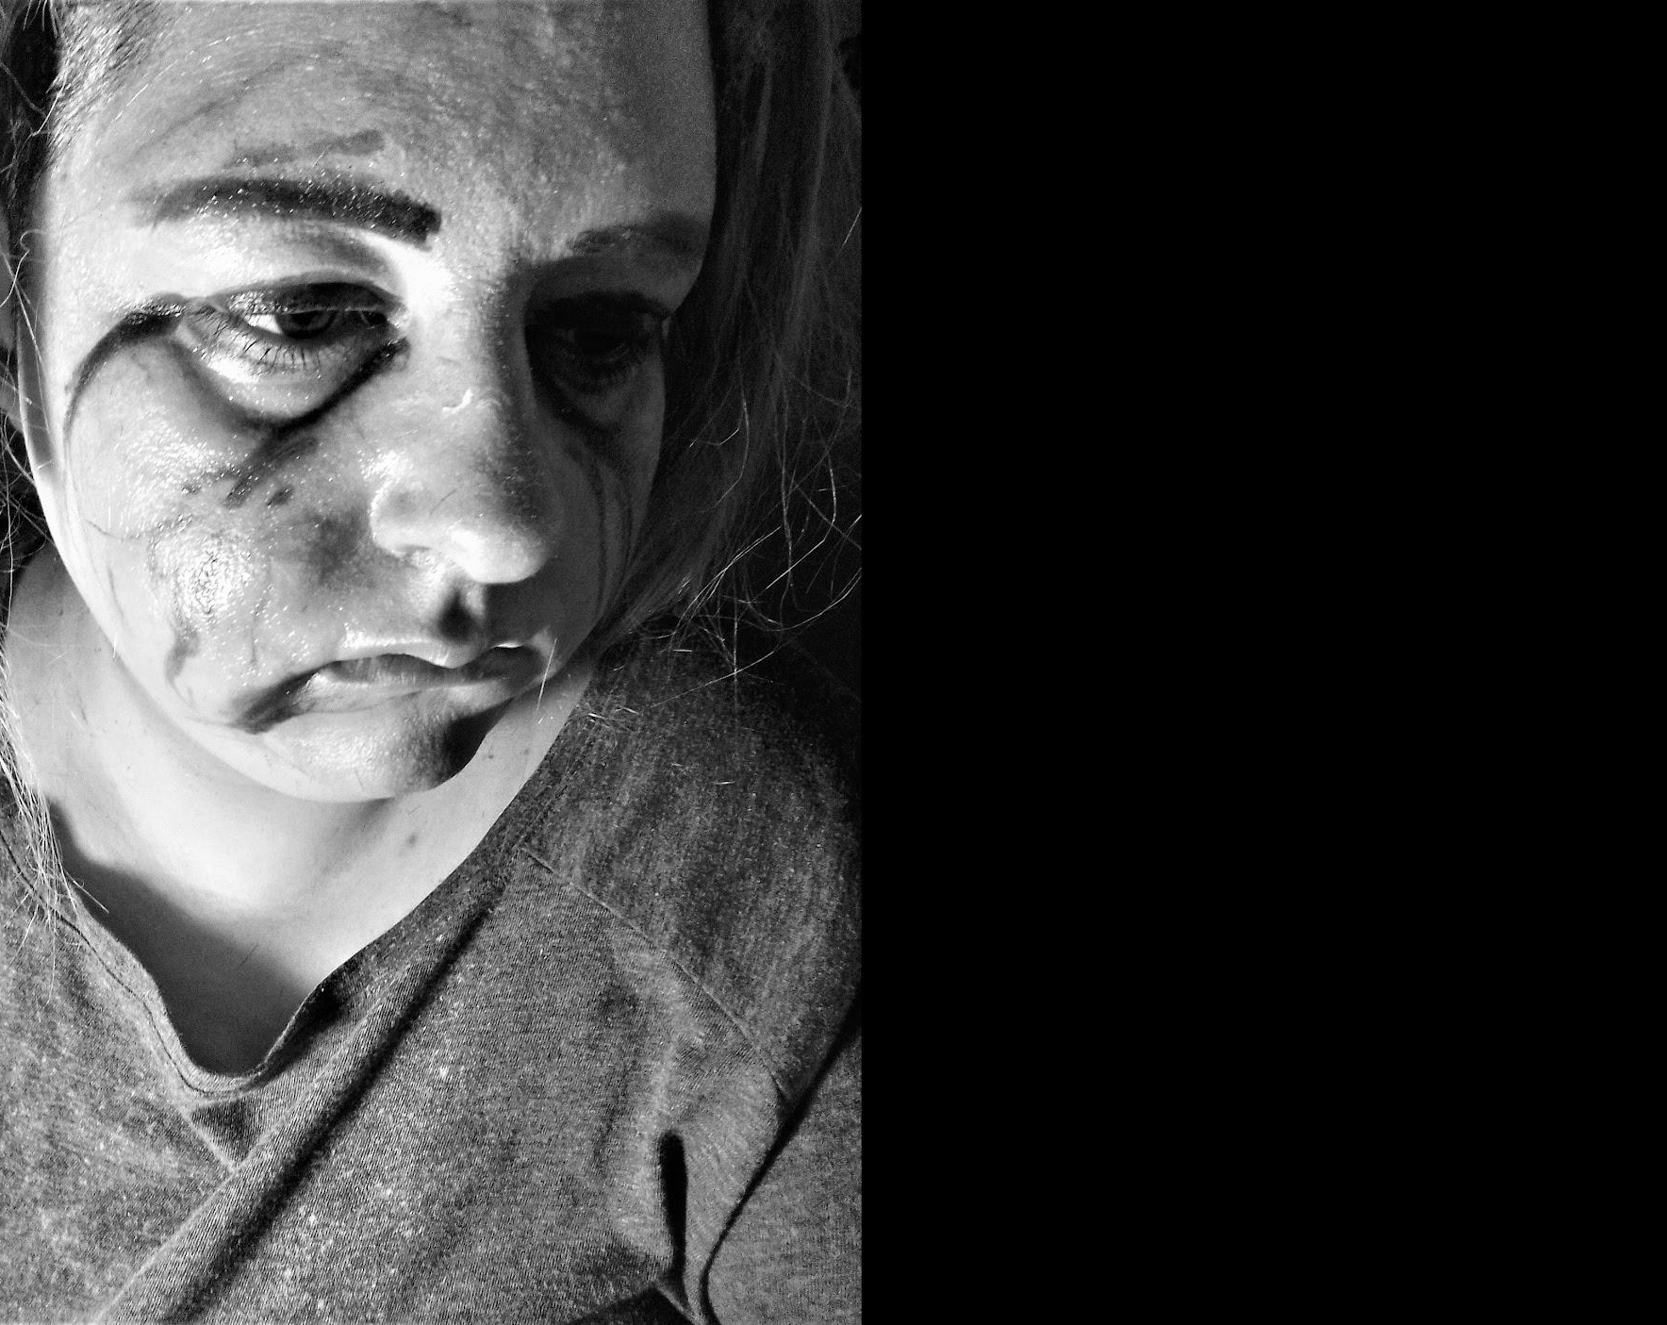
GROWTH
AWARENESS
PROTECTION
‘people don’t buy WHAT; you do; they buy WHY; you do it!’

Slide 9
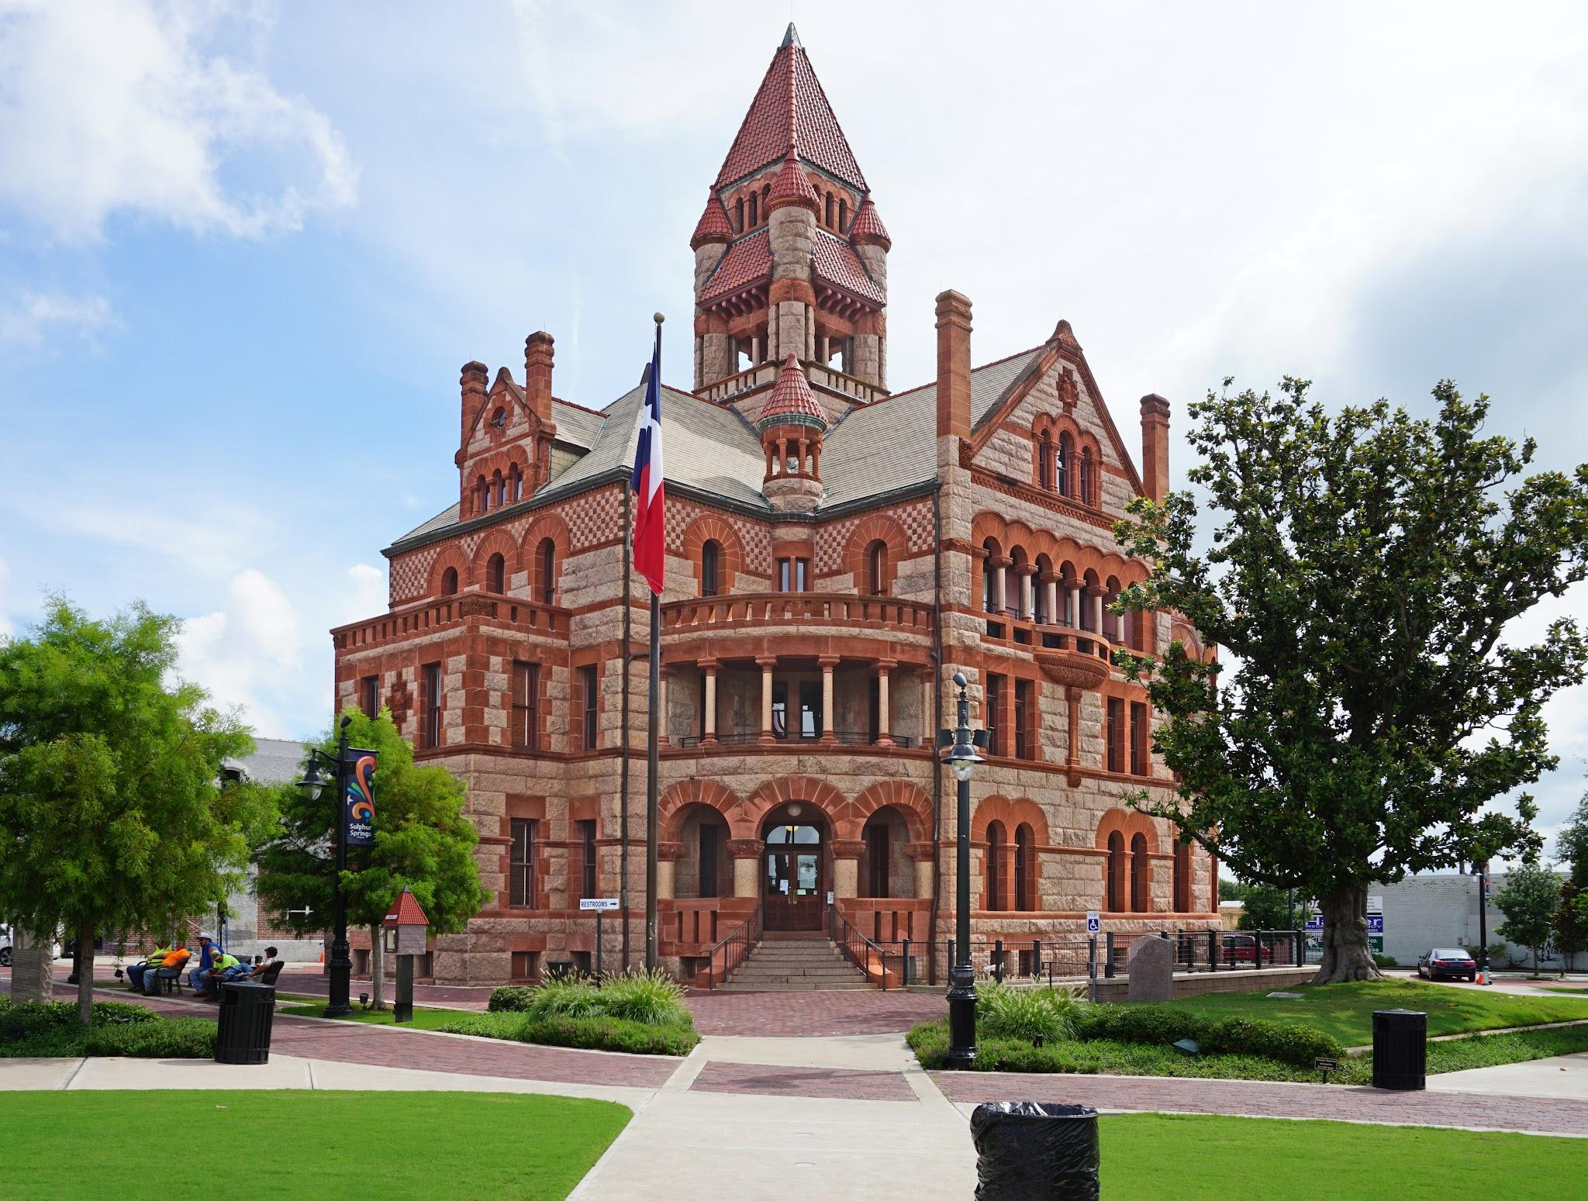
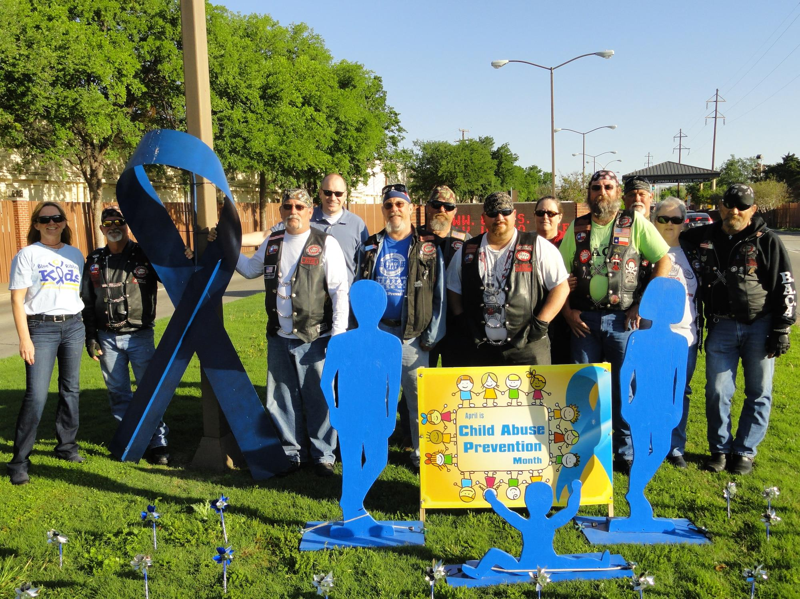
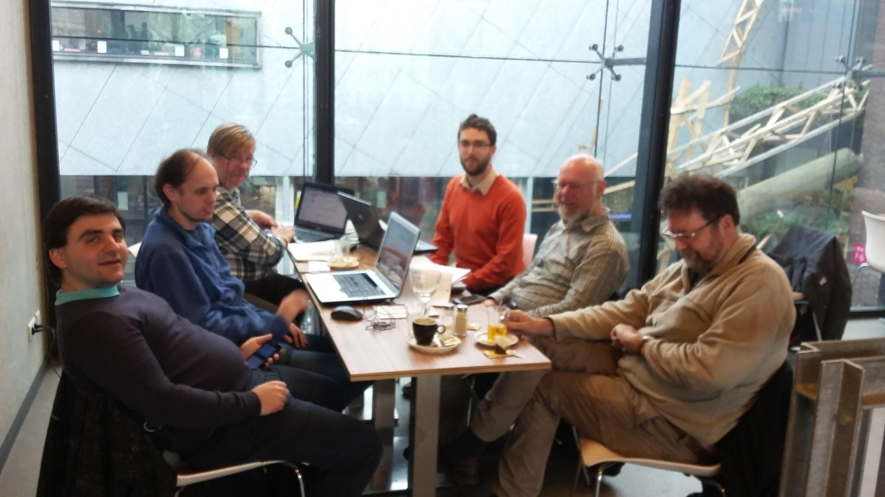
Intended Audience
The Collaborators
The Government Inities
The Local Board
Page #

Slide 10
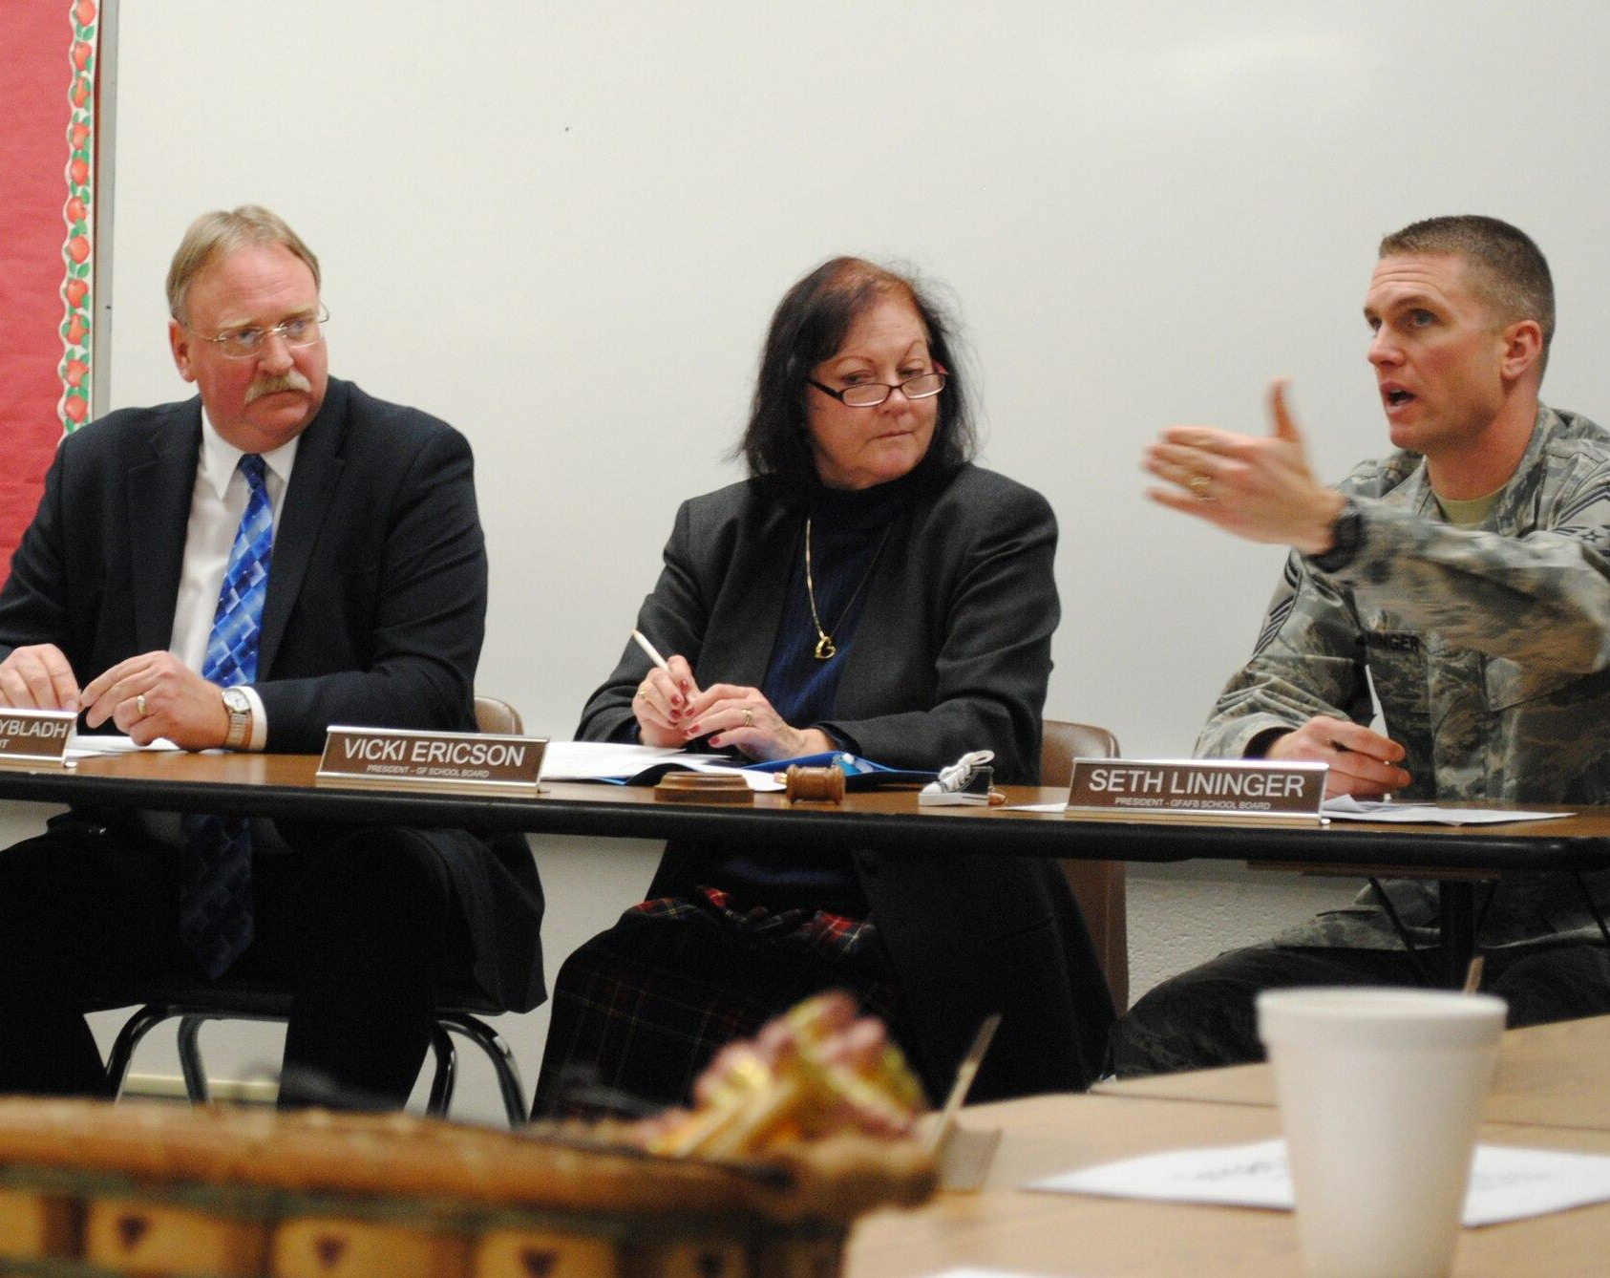

Membership
Retired Teachers
Nurses
Elected Officials and/or Spouses
Law Enforcement Spouses
Church Leaders
Retired CPS/DFPS Employees
Commissioner Court
HOW
WHY
WHAT
When searching for board members always remember the Golden Circle: the WHY, the HOW, and the WHAT!

Slide 11
INSPIRE!
Two criteria ranked in a survey by Mitch Ditkoff and Tim Moore of Idea Champions, Carolyn Allen of Innovation Solution Center and Dave Pollard of Meeting of Minds reveals that :
Enthusiasm
Open-mindedness
Rank more important than:
Experience
Familiarity with team members
Reputation
Great Leaders all INSPIRE:
APPLE
Martin Luther King
Wright Brothers
Ronald Reagan

Slide 12

Open Meetings Act
  Within 30 days
  Open Meetings Act Training | Office of the Attorney General
CPS Volunteer Registration
  Form C-105-0205
  Confidentiality Statement
  14 days from appointment
Background Checks
  Department of Family Protective Services
Information Act
  Not required, but I recommend
  Public Information Act Training | Office of the Attorney General

Slide 13

FUNDING
Comes from many different avenues:
County General Fund
County Juror Donations
Municipal Funds
School District Funds
TCCWB Specialty Licence Plates
CWB Fundraisers
Corporation or Foundation Grants

Slide 14
Who do think of when I say HERO?

Slide 15
Who do think of when I say HERO?
—-------------------------------------------------------------------
First responder? Moses? Yourself?

Slide 16
The PAST?

Slide 17
What or Who is a HERO?
People/Board Members
Fundraisers
Policy and Procedures
Vision and Mission Statements
CPS and DFPS
Meeting Time and Place
Commissioner’s Court members
CBC
YES, WE RESPECT THE PAST.
AT TIMES WE REVERE THE PAST.
BUT WE CAN’T LIVE IN THE PAST.
Thom S. Rainer

Slide 18
Let me repeat it one more time…
YES, WE RESPECT THE PAST.
AT TIMES WE REVERE THE PAST.
BUT WE CAN’T LIVE IN THE PAST.
Thom S. Rainer

Slide 19

How to be Successful 101:
Regular Meetings with Communication
Good Inspired Board Members
Don’t Think Small
  ’Don't be a Hero to the Past’
Include the Courts in your Efforts
Try not to Reinvent the Wheel
  ’Don’t be a Hero to the Past’
Work/Play well with Others
Communicate

Slide 20
Please use this QR code to view this presentation.
Thank you.

Slide 21


Jason T Williams
Mills County Commissioner Precinct 4
Central Texas Council of Child Protection Board President, Region 7
Mills County Courthouse
P.O. Box 483
Goldthwaite, TX 76844
Courthouse: 325-648-2222
Cell: 325-451-0022
jason.williams@millscountytx.gov

