Slide 1


Welcome to the
TCCWB All Hands-On Deck Conference
February 23rd-25th, 2025
BOARD FUNDAMENTALS
Sit Dolor Aet
George Ford – TCCWB Executive Director, LMSW-AP J.D.
Diane Anderson-Glover – TCCWB President
Dr. Tim Allen – Former TCCWB President PHD

Slide 2

How a Child Welfare Board is Established
Texas in unique in the sense that it is the only state in a state administered Child welfare system which has provision for child welfare boards
In 1919 The Board of Control was created by the Texas Legislature and was composed of three members appointed by the Governor for six (6) year overlapping terms.
In 1931 in response to the Great Depression, Texas created the Division of Child Welfare Services under the State Board of Control. The law allowed County Commissioners Court to appoint boards of 7 to 15 persons to coordinate community services for the protection of children.

Slide 3
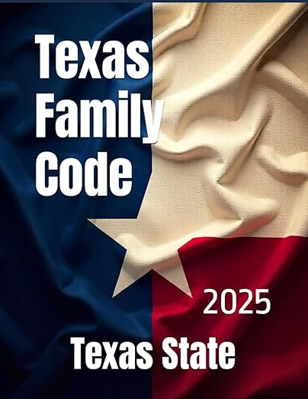
How a Child Welfare Board is Established (continued)
The authority is codified in Sec 264.005 of the Texas Family Code.
Legal Requirements to establish a child welfare board
Child welfare boards are not mandatory
Provision for a child welfare board to represent more than one county
A County child welfare board is a governmental unit for the purposes of Chapter 101 Civil Practice and Remedies Code
A county child protective service board may receive information that is confidential under section 40.005 Human Resources Code or Section 261.201 when the board member is acting in the members official capacity.

Slide 4

How a Child Welfare Board is Established (continued)
A child welfare board may conduct a closed meeting under section 551.101 Government Code to discuss, consider or act on a matter that is confidential under 40.005 Human Resources Code.
The commissioners court of a county may appropriate funds from it ‘s general fund or any other fund for the administration of its county child welfare board
The court may provide for services to and support of children in need of protection and care without regard of immigration status of the child or the child's family

Slide 5

CWB’s and the Texas Family Code § 264.005
The Commissioner’s Court may appoint a Child Welfare Board.
The board SHALL have not less than 7 members and not more than 15.
The Members serve at will of the Commissioner’s Count with no compensation and may be removed by the court for just cause.
Two or more counties may establish a joint board
The local board is governmental unit for purposes of the Chapter 101 Civil Practice and remedies Code.
A Commissioner's Court may appropriate funds
The Child Welfare Board may provide service and support to all children without regard to immigration status.

Slide 6
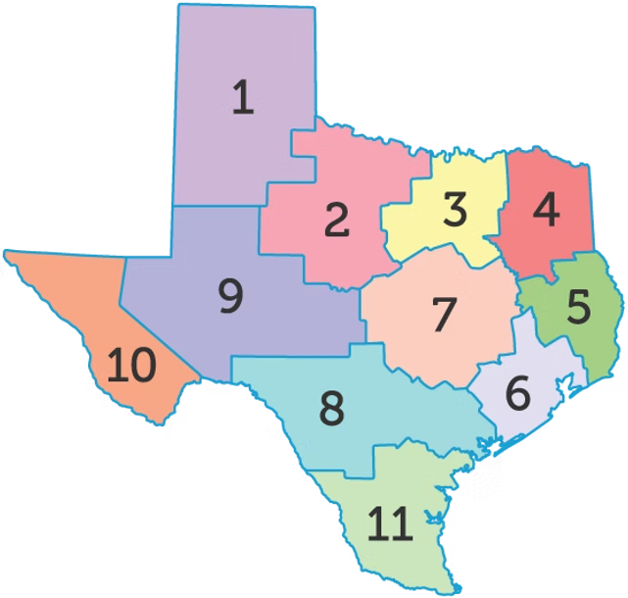
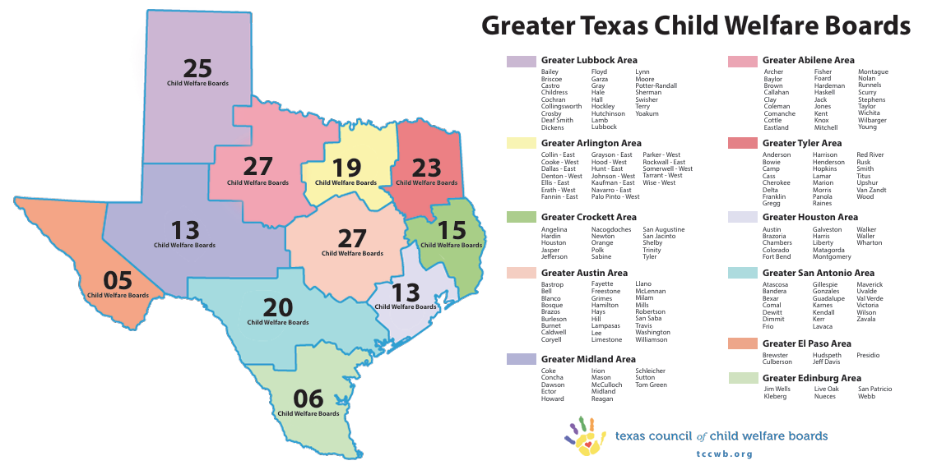
Regional Map & Active CWB’s by Region Map
192 active Child Welfare Boards out of 254 counties in Texas.

Slide 7
Regional Council of Welfare Boards
Regional Councils provide training and information on regional and statewide issues, especially issues impacting services to families and children.
Each Regional Council operates according to the region’s needs and wishes. In most instances, each county CWB sends one or two delegates as their representative to the Regional Council meetings.
Each regional council elects two or three delegates to represent their region at the Texas Council of Child Welfare Boards meetings.

Slide 8
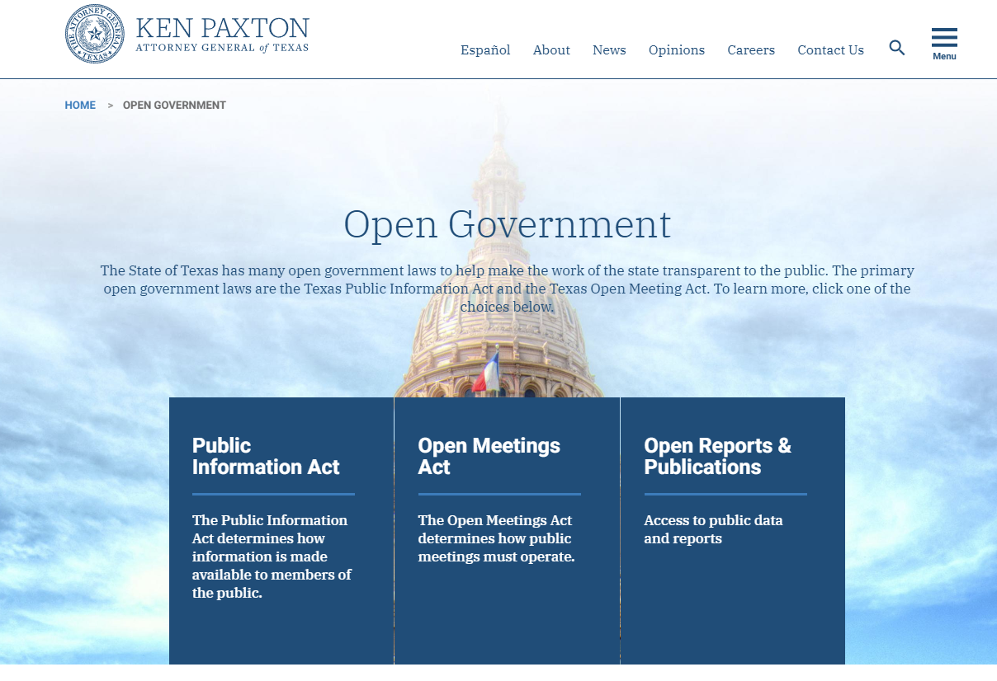
OMA & PIA
Open Meeting Act & Public Information Act Training
Located on the Texas Attorney General's Website at the following link:
https://www.texasattorneygeneral.gov/open-government
Training should be completed within 90 days of appointment by the Commissioners Court
At the end of the training video’s, answer the questions at the end to receive your certificate.
Submit a copy of the two certificate to the CWB President / Chair.

Slide 9

Website Basics
Website – launched a more modern and user friendly website in Spring 2023
Major challenge is keeping information updated –
  CWB Board Presidents / chairs –
  Regional CWB Contacts –
  DFPS / FBCE staff updates –
  Number of Active CWB's
  Rainbow Room contacts & information
  How can you HELP?

Slide 10
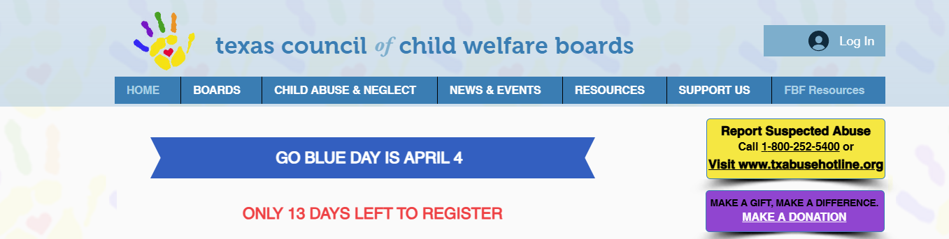
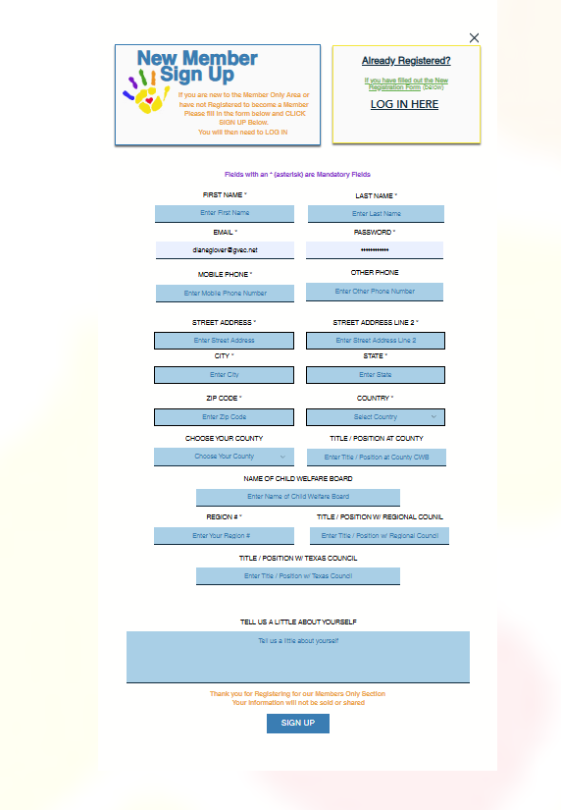
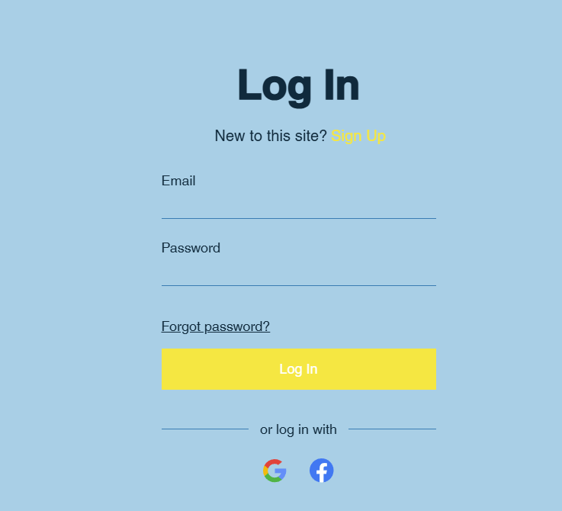
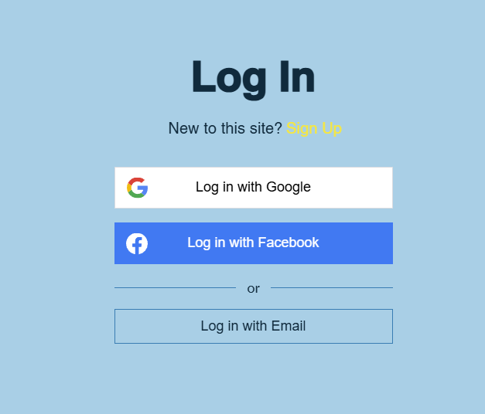
Website Basics
Create account
Log in
Members Only Section
Reporting updates needed and or issues

Slide 11
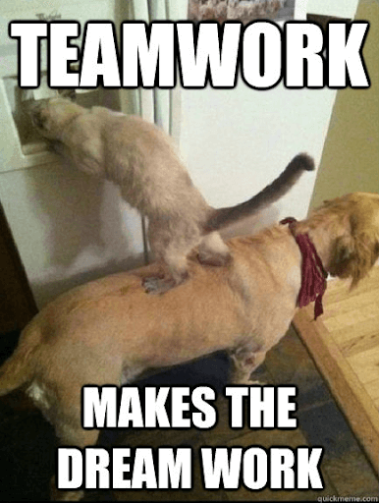
Everyone has a Story
Great organizations begin to fail when we start worshipping our Methods and forget the Message.

Slide 12
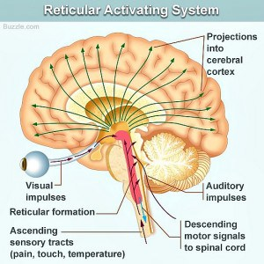
The reticular activating system (RAS)

Slide 13
RAS
Things that are Unusual
Things that Threaten you
Things that are of Value

Slide 14
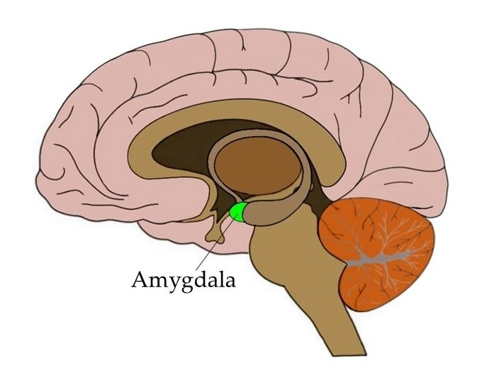
The Amygdala

Slide 15
Everyone has a Story…
… especially in situations involving anxiety, fear, or rage

Slide 16
Working together we can validate their Stories.
Each Child has a Narrative
The Courts have a Narrativize
DFPS – Workers have a Narrative
Parents have a Narrative
The Community has a Narrative
Your Region Child Welfare Board has a Narrative
Your Local Child Welfare Board has a Narrative

Slide 17
Your State, Regional and Local Child Welfare Boards help define and combine these narratives.
Faith Based and Community Initiatives are here to help

Slide 18
Texas is the Only State that has implemented County Child Welfare Boards

Slide 19
Working Together We Can Become Part of The Solution
Learn How to Remove Programs That Do Not Work
Example: ASBO Laws in England 2001
DFPS Mission
Community Based Care

Slide 20
The ABC’s of
Transition
A- Be Authentic
B- What are your Belief Systems?
C- What are the Consequences if I continue to believe this way?
D- What is the Debate?
E- Ever after… How do we live happily ever after?

Slide 21
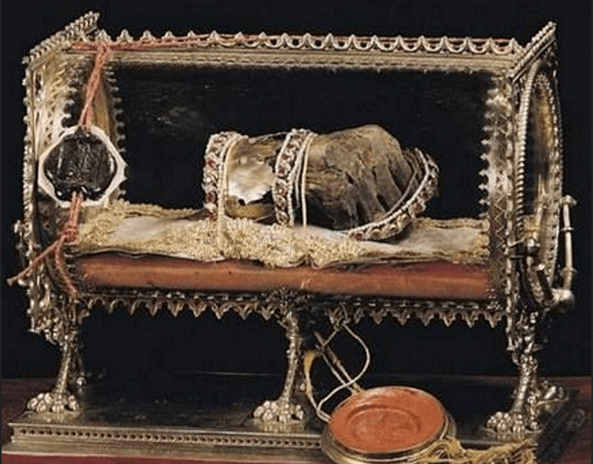
Relic –
…an object surviving from an earlier time, especially on of historical or sentimental interest.

Slide 22

Relevant –
…Appropriate to the current time, period, or circumstances; of contemporary interest.

Slide 23

Thank you for Attending
TCCWB All Hands-On Deck
Conference 2025
Board Fundamentals
A link for this PowerPoint Presentation will be available on the TCCWB Website, in the Members Only Section after the conference under
– Articles – Documents - Handouts & Manuals
www.tccwb.org

